Slide 1
Community Development Programme Dhule Solar Park of AMPYR July 2024 to Dec 2024 Meeting Date : 11 December 2024

Slide 2
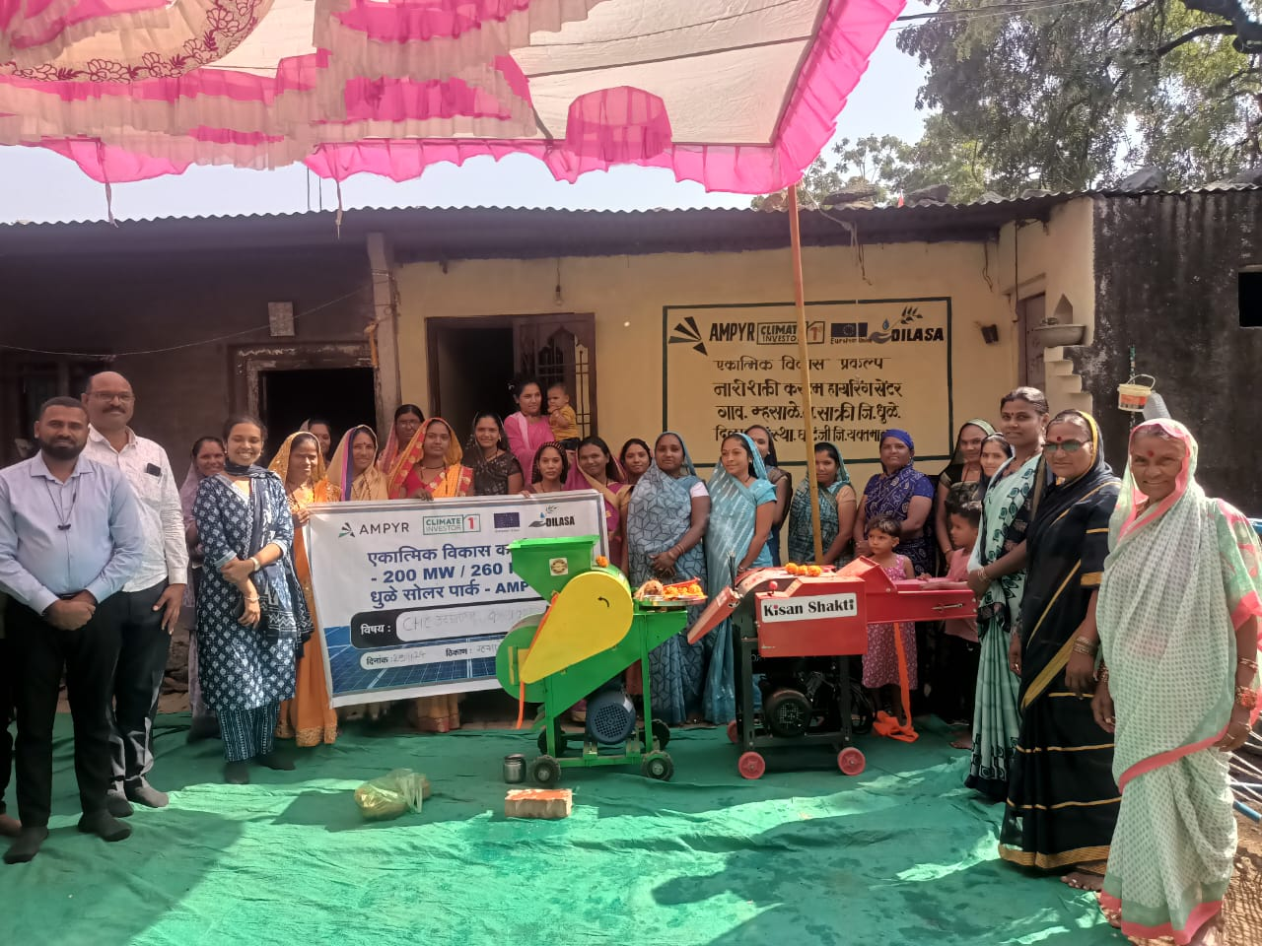
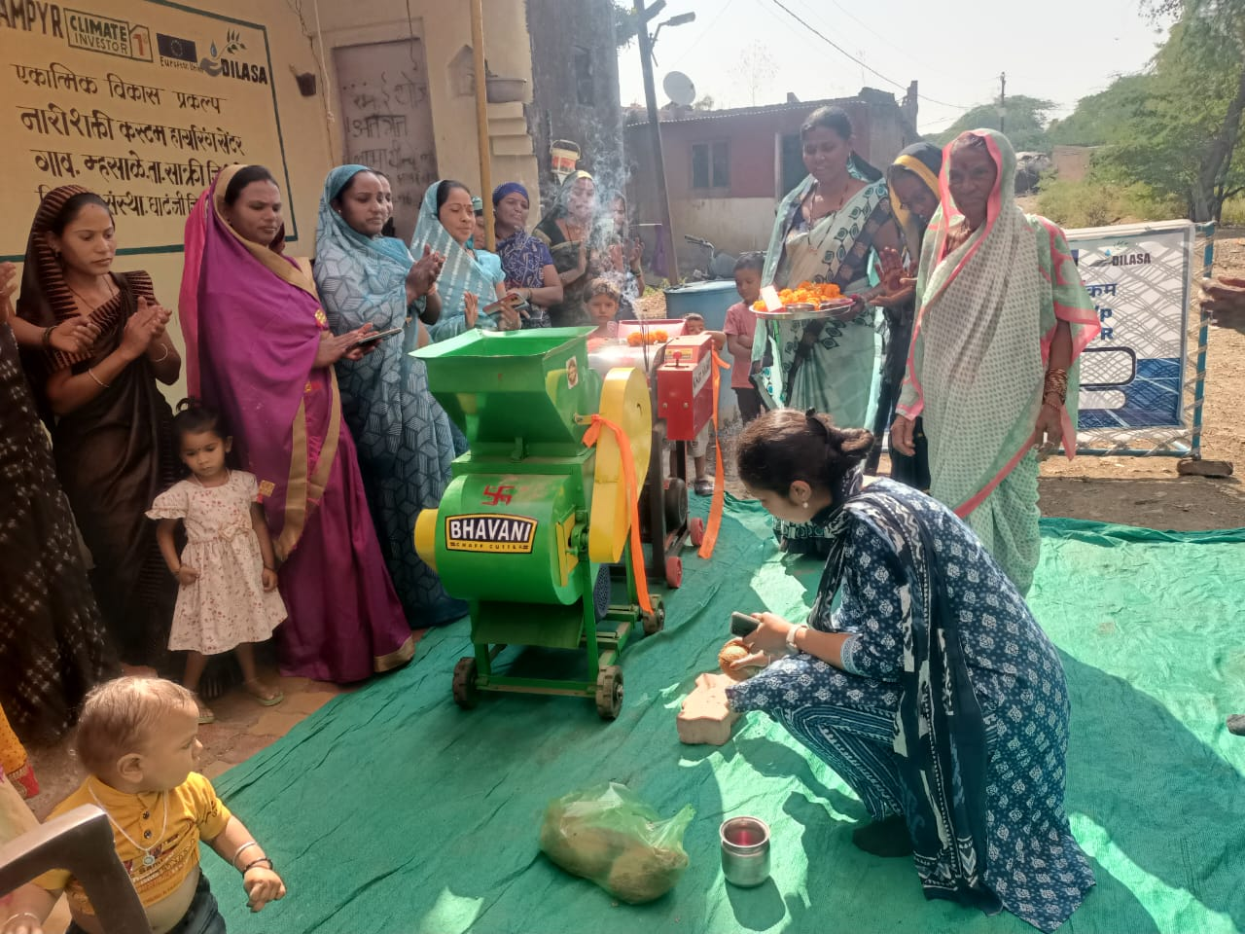
Activity Progress : (Period 27 Nov 2024 to 11 Dec 2024) The Nari Shakti Custom Hiring Center in Village Mhasale was inaugurated by AMPYR's Safety Head, Mrs. Priyankaji and Mr. Syedji , along with Village Development Committee's members Dr. Dilip Dashpute, Mr. Sunil Wankhade (Police Patil), and Gram Panchayat Member Yogesh Pardhi, through a ribbon-cutting ceremony. Custom Hiring Center equipment, including a Thresher Machine, Peanut Splitting Machine, and Chaff Cutter, was handed over to the group on 29 Nov 2024.
CHC members with Chaff Cutter and Peanut splitting machine

Slide 3
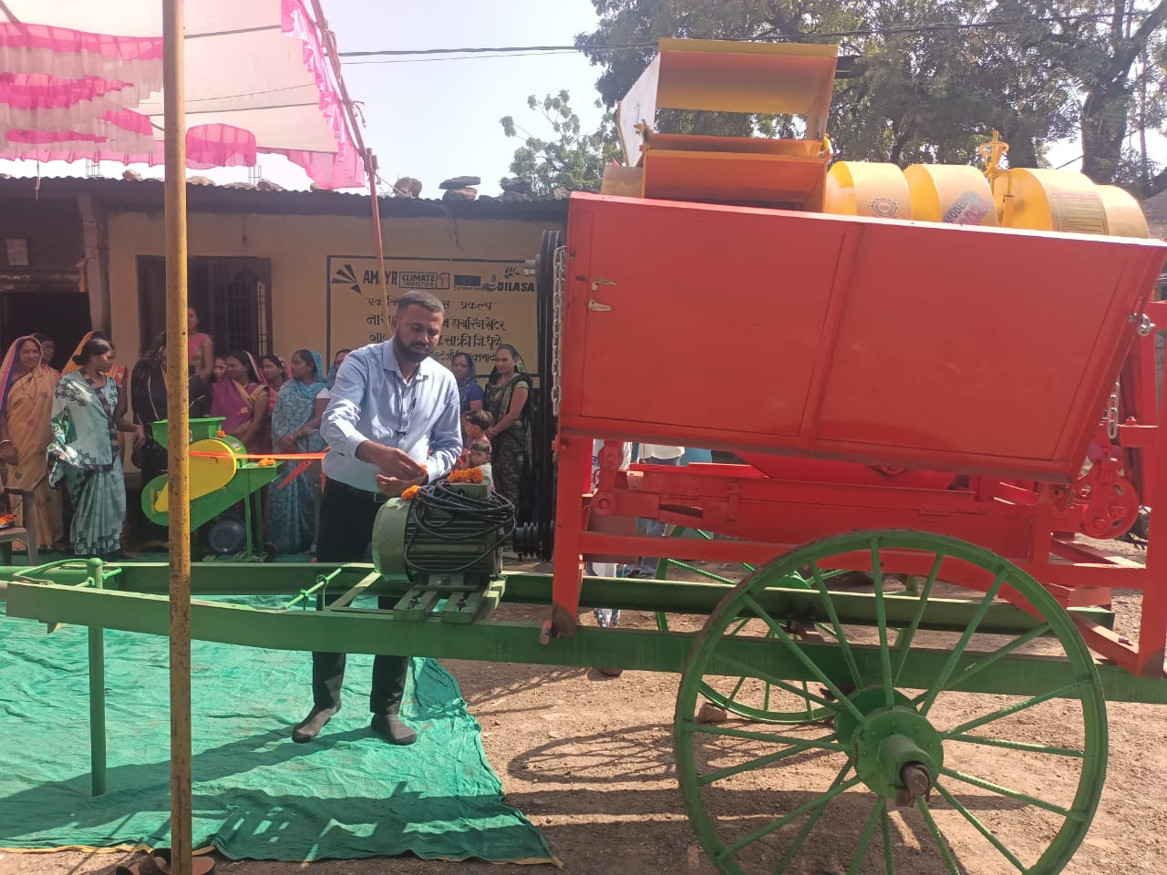
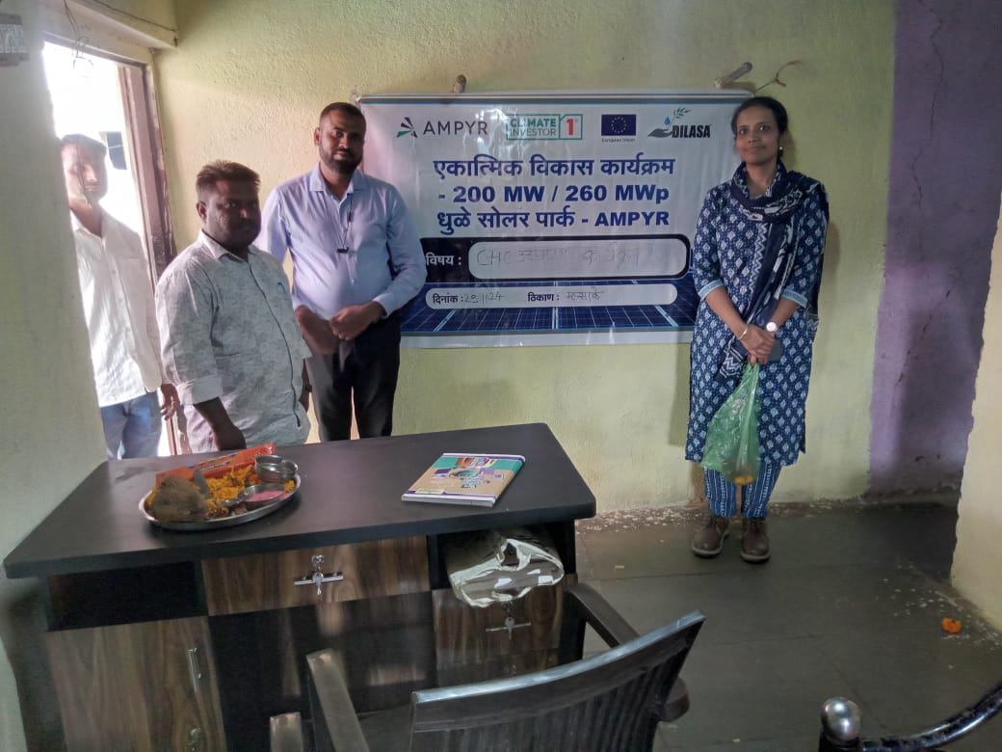
Activity Progress : (Period 27 Nov 2024 to 11 Dec 2024)
Thresher machine
The AMPYR team members visited to inspect the renovation work of the Custom Hiring Center (CHC) room.

Slide 4
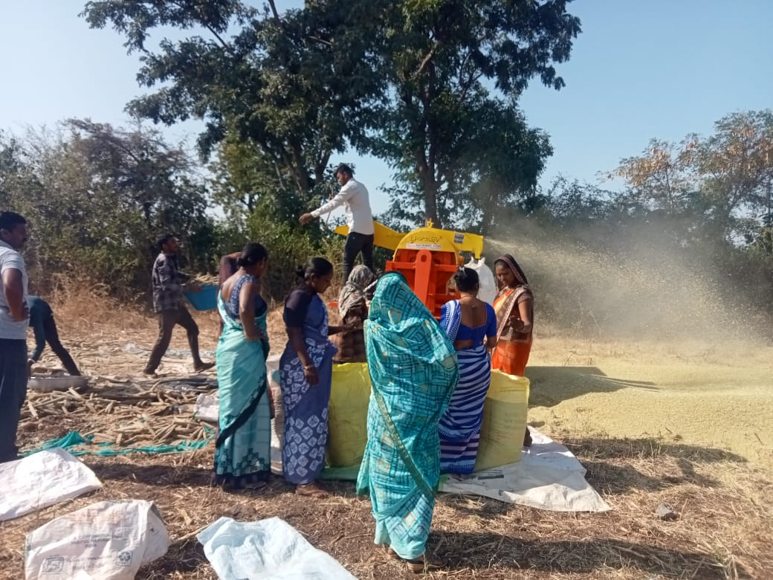
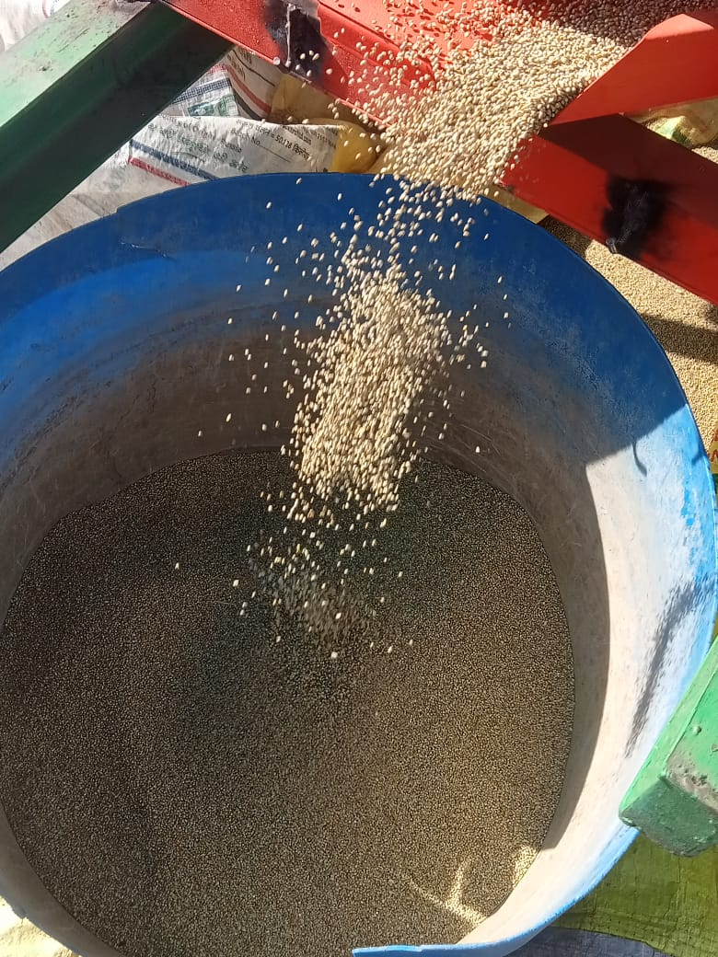
Activity Progress : (Period 27 Nov 2024 to 11 Dec 2024)
Custom Hiring Centers (CHCs) women members harvesting millets on thresher machines

Slide 5
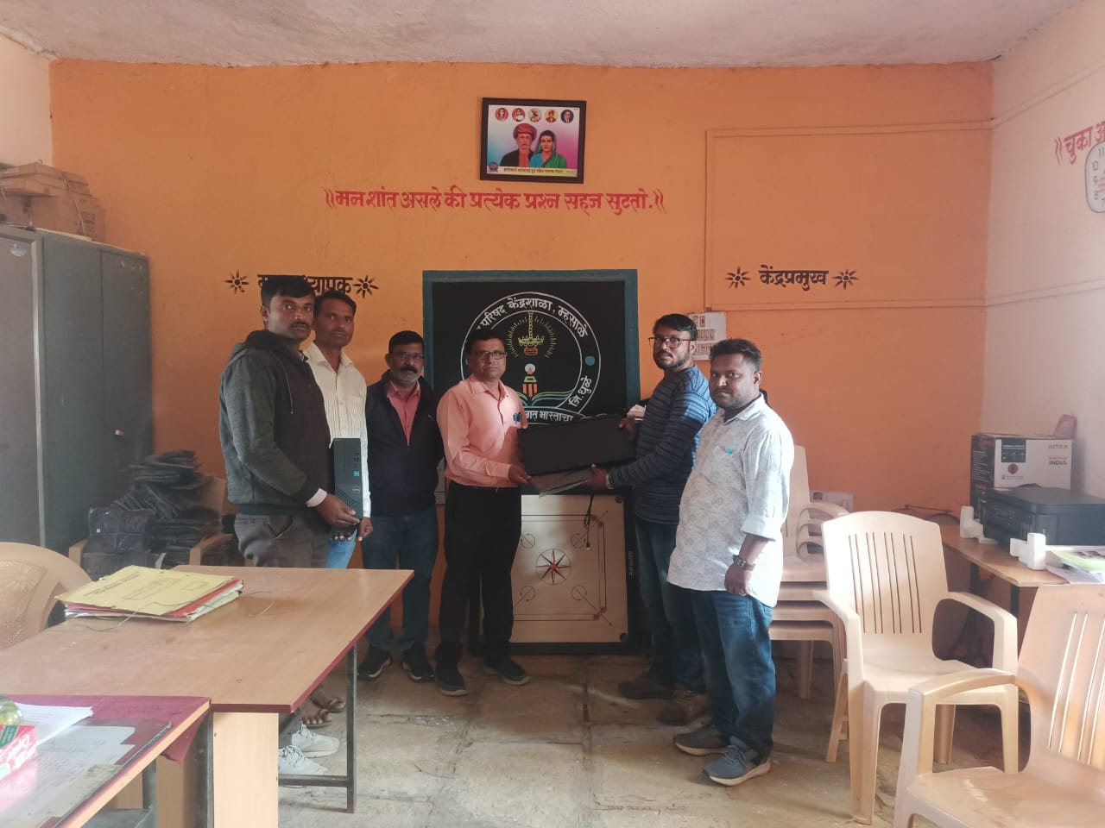
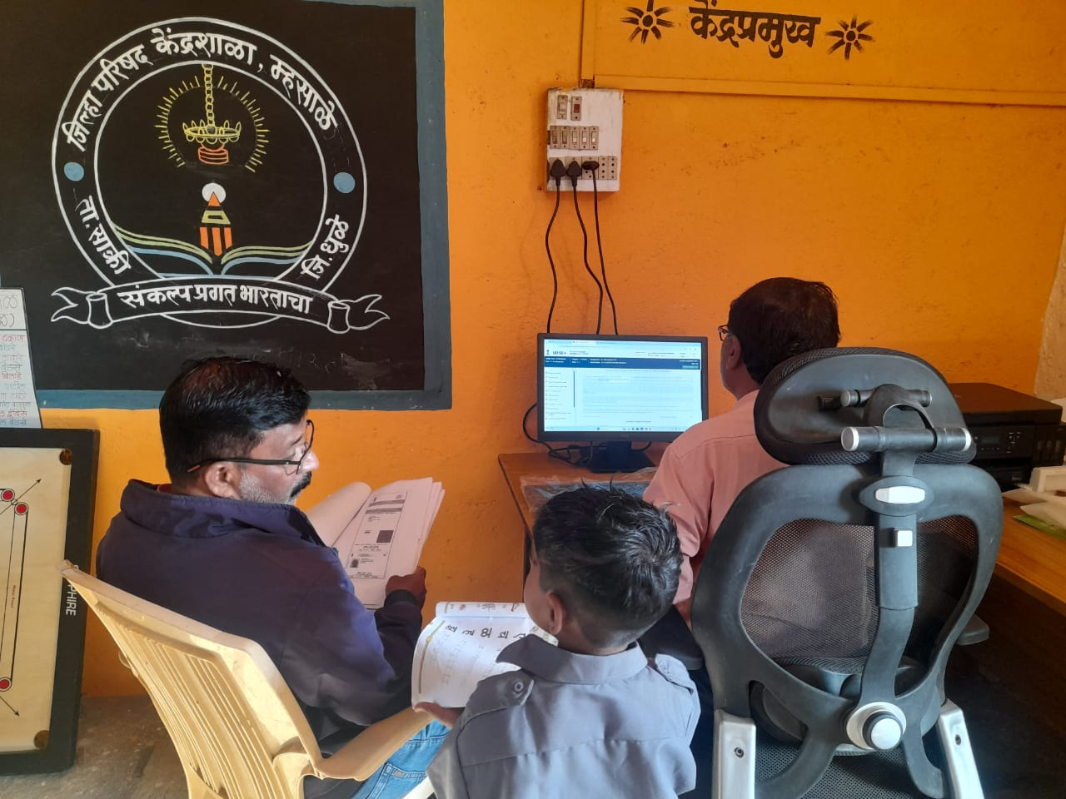
Activity Progress : (Period 27 Nov 2024 to 11 Dec 2024)
Computer were distributed to the Zilla Parishad Marathi School in Village Mhasale under the Integrated Development Proramme, facilitated by Dilasa Sanstha.
School principals and teachers are filling out their students' scholarship forms online using computer.

Slide 6
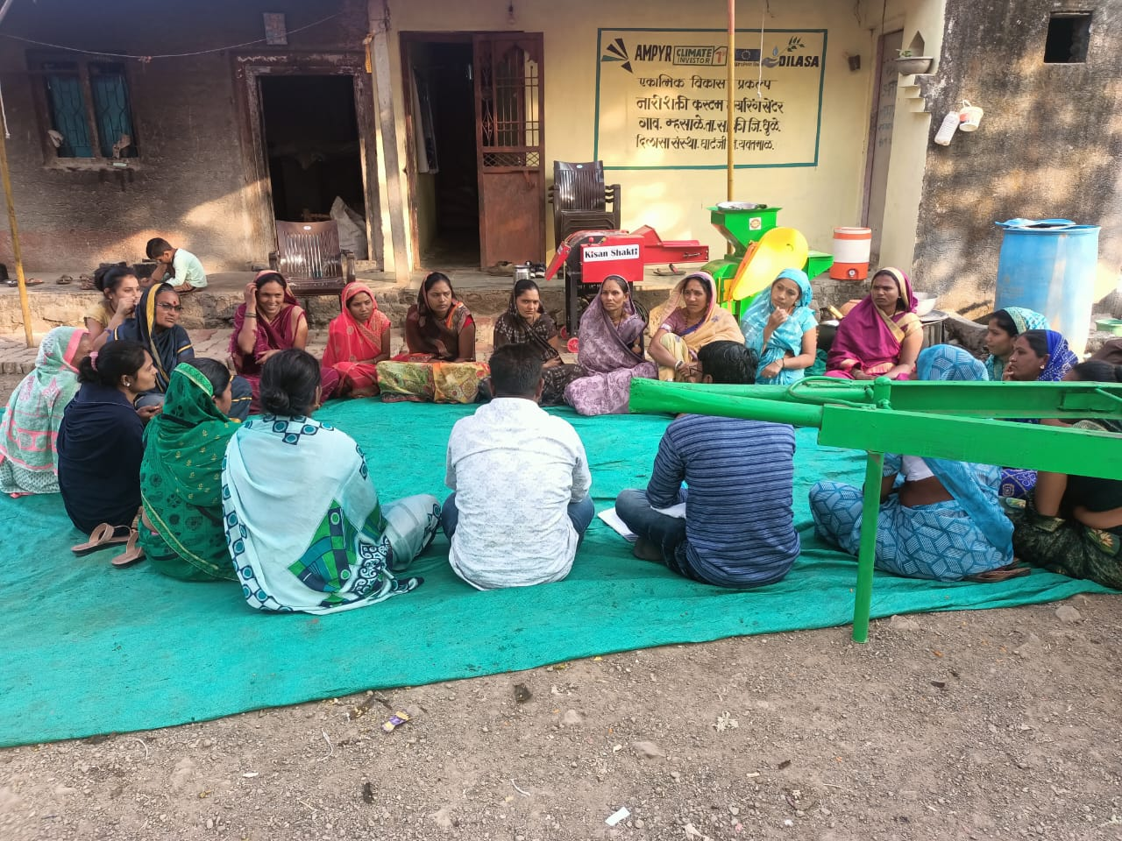
Activity Progress : (Period 27 Nov 2024 to 11 Dec 2024) On 29 November 2024, a training session on record management was organized for all members of the Custom Hiring Center (CHC) group. Mr. Pawan Nakhate, serving as the resource person, provided guidance on effective record management. Following discussions with the group members, four committees were formed as follows: 1. Management/Supervision Committee 2. Record Keeping Committee 3. Repair and Maintenance Committee 4. Grievance Committee
Record Keeping training of CHC Members.

Slide 7
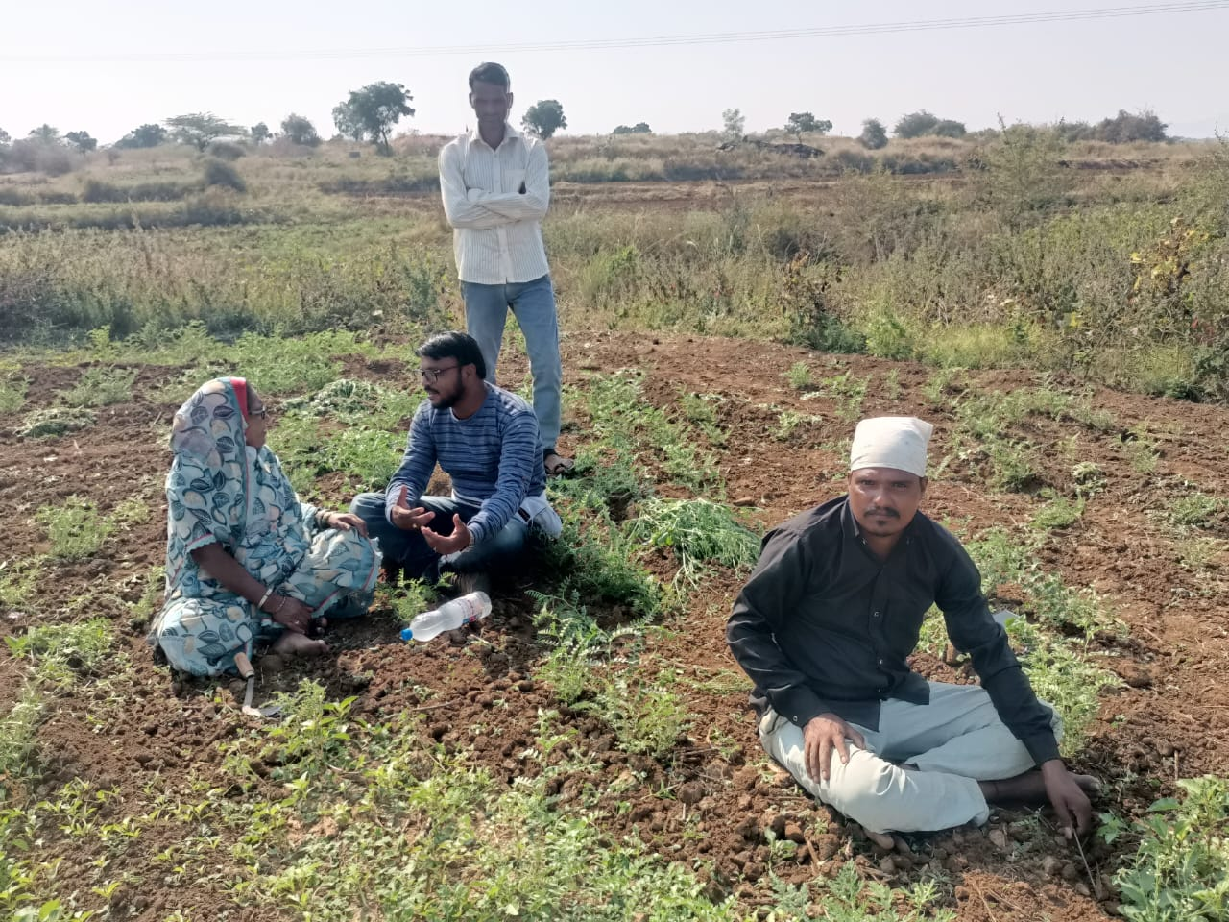
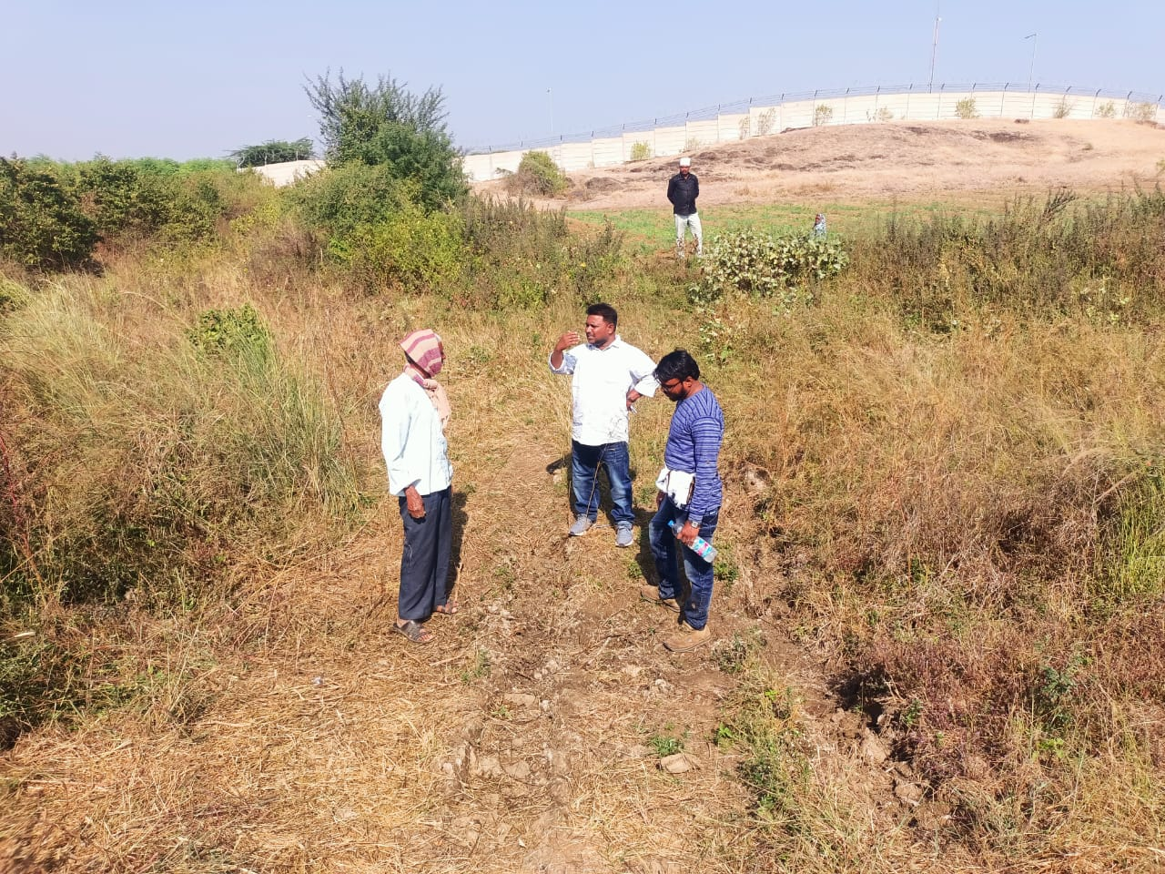
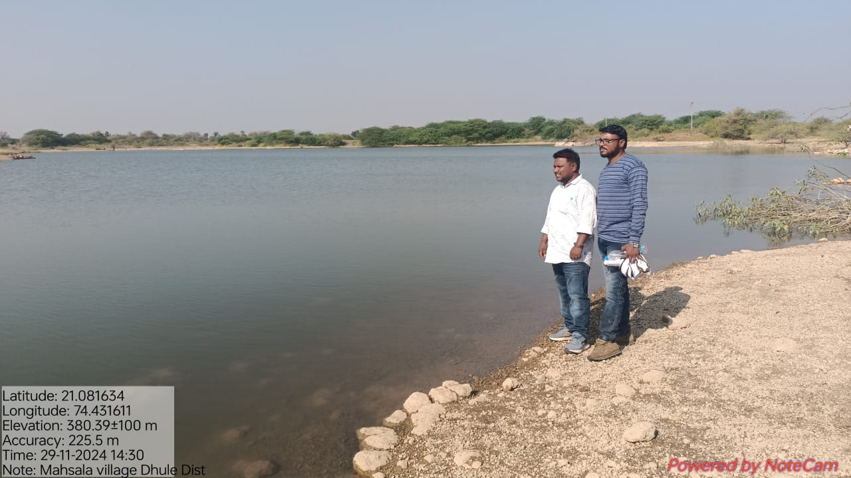
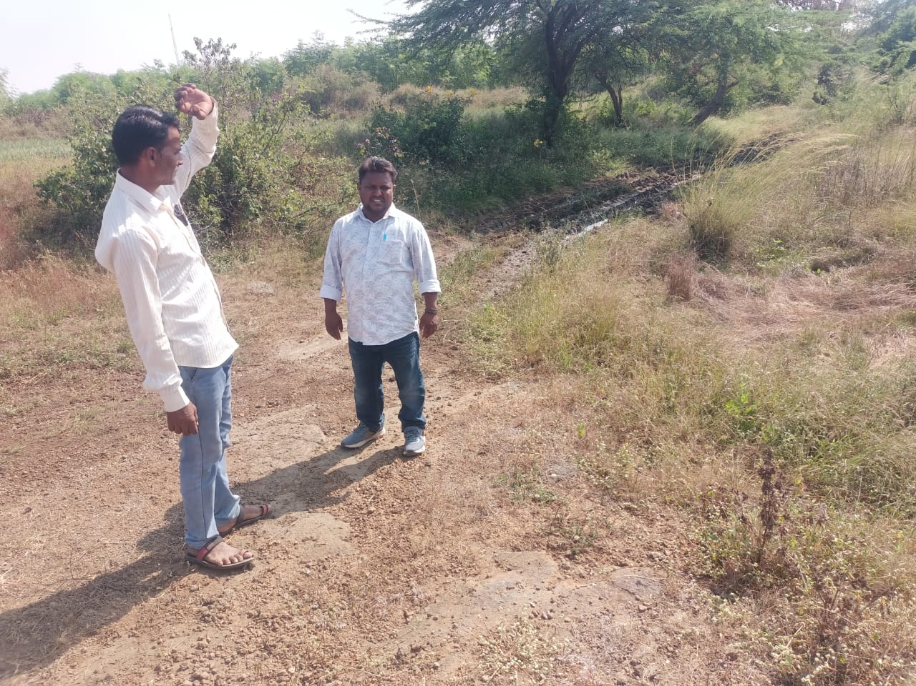
Activity Progress : (Period 27 Nov 2024 to Dec Nov 2024) For water-related dam de-siltation works, the incident site in Mhasale Shivar was visited, and discussions were held with the farmers present. However, due to the presence of water in the pond, removing the silt is currently not feasible. After discussing with farmers, villagers and as per site we are proposing following watershed activities : 1. Animal Water Tank 2. Recharge Pit 3.Recharge Shaft 4. Farm pond
Current water conditions in the pond.
A Dilasa representative discussing with farmers

Slide 8
Planned Activities : (Period 11 Dec 2024 to 25 Dec 2024) Selecting beneficiaries according to activities Custom Hiring Centers (CHC) will install rate boards in public areas of the village to display equipment rental rates. Discussion on following point : Fund requisition LED TV requisition

Slide 9
Thanks

